Slide 1
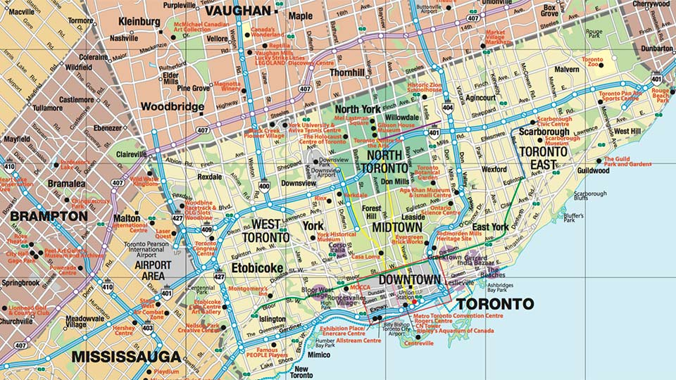
Airbnb Price in Toronto
By Thomas Kwok

Slide 2
Introduction
Data from tomslee data website
3501 observations
15 variables
'$ room_id : int 18134212 17810098 14398733 14800586 15867502 14842737 15753679 6706563 15248624 18253328 ...
$ survey_id : int 1428 1428 1428 1428 1428 1428 1428 1428 1428 1428 ...
$ host_id : int 40265704 107052775 88500861 85744952 48292411 92598277 59327430 1218816 75472140 63351876 ...
$ room_type : Factor w/ 1 level "Entire home/apt": 1 1 1 1 1 1 1 1 1 1 ...
$ city : Factor w/ 1 level "Toronto": 1 1 1 1 1 1 1 1 1 1 ...
$ neighborhood : Factor w/ 124 levels "Agincourt North (129)",..: 79 6 11 24 30 72 78 64 37 72 ...
$ reviews : int 21 32 16 18 42 46 31 50 65 14 ...
$ overall_satisfaction: num 4.5 4.5 5 4.5 5 4.5 5 5 5 4.5 ...
$ accommodates : int 2 3 4 3 2 2 2 3 4 2 ...
$ bedrooms : int 0 1 1 1 1 1 0 1 2 1 ...
$ price : int 38 41 28 23 40 38 34 36 32 38 ...
$ last_modified : Factor w/ 3501 levels "2017-07-10 08:47:19.265152",..: 1 2 3 4 5 6 7 8 9 10 ...
$ latitude : num 43.7 43.8 43.8 43.7 43.7 ...
$ longitude : num -79.3 -79.4 -79.3 -79.2 -79.4 ...
$ location : Factor w/ 3501 levels "0101000020E6100000001DE6CB0BD953C07BF7C77BD5D24540",..: 2075 3112 1341 2692 3076 2194 650 32 465 409 ...

Slide 3
Introduction Pt 2
Variables of Interest: Price, Neighborhood, Reviews, Overall Satisfaction, Accommodates, Bedrooms, Longitude, Latitude
Question: What factors go into determining Airbnb price? Is it possible to create model to predict Airbnb price?

Slide 4
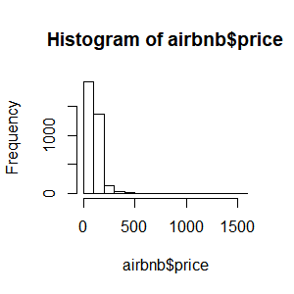
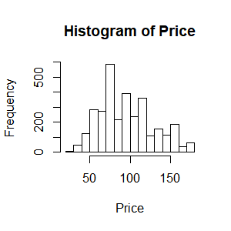
Airbnb Price
summary(airbnb$price)
Min. 1st Qu. Median Mean 3rd Qu. Max.
22.0 72.0 96.0 112.9 131.0 1599
R < quantile(airbnb$price, seq(0,1,by=0.1))
0% 10% 20% 30% 40% 50% 60% 70% 80% 90% 100%
22 58 70 78 88 96 108 119 143 180 1599
R < quantile(airbnb$price, seq(.9,1,by=0.01))
90% 91% 92% 93% 94% 95% 96% 97% 98% 99% 100%
180 183 196 200 203 231 239 260 304 400 1599

Slide 5
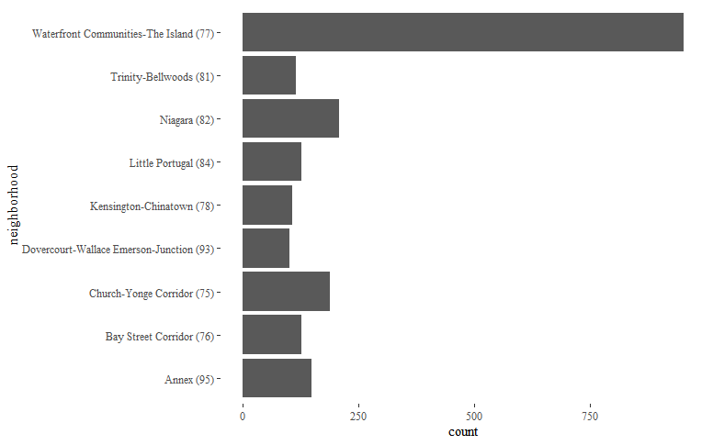
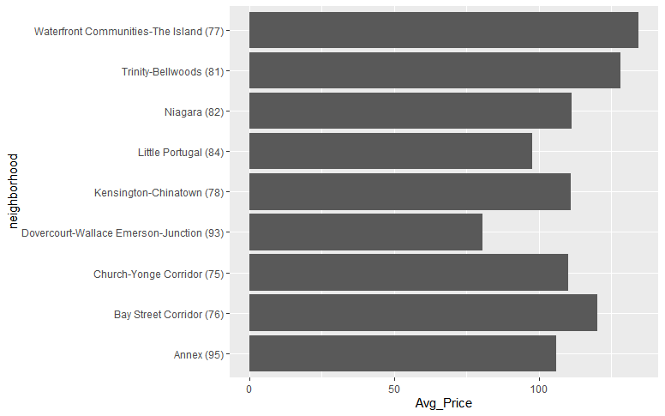
Neighborhoods

Slide 6
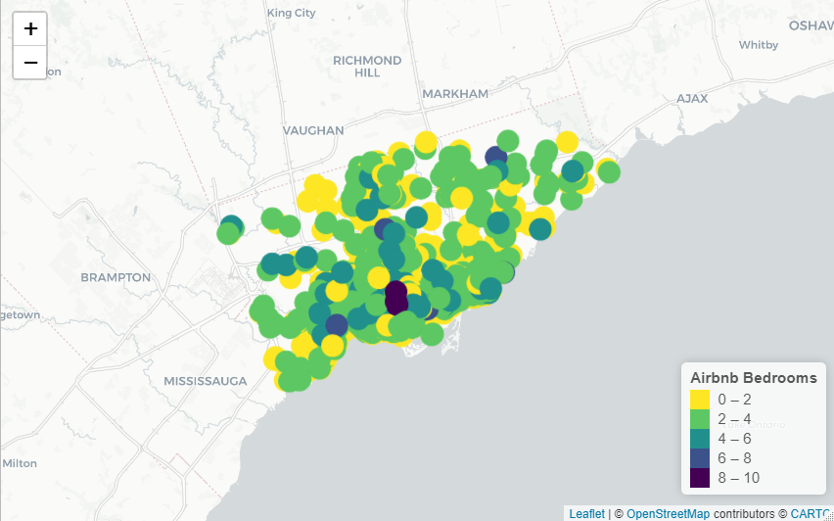
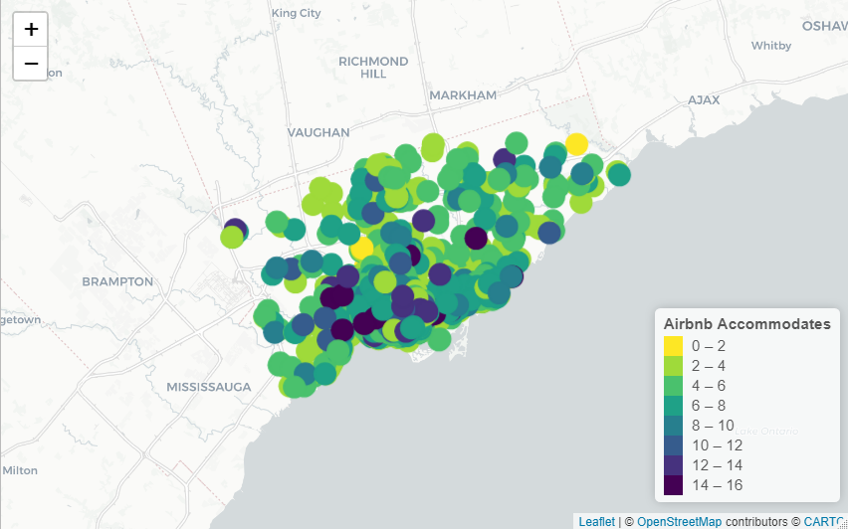
Exploration #1: Heat Maps
Radius: 10
Radius: 10

Slide 7
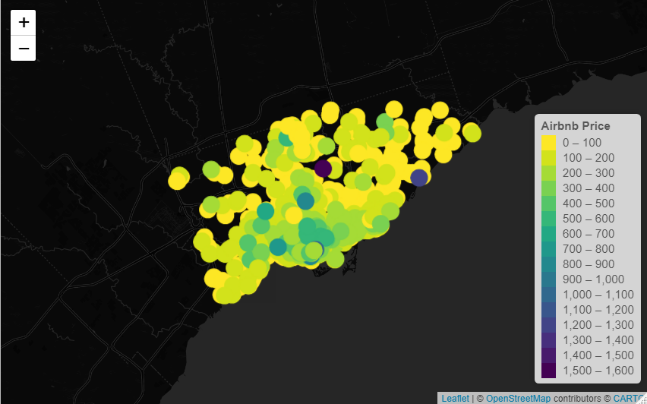
Exploratory #2: Price Heat Map
Radius: 10

Slide 8
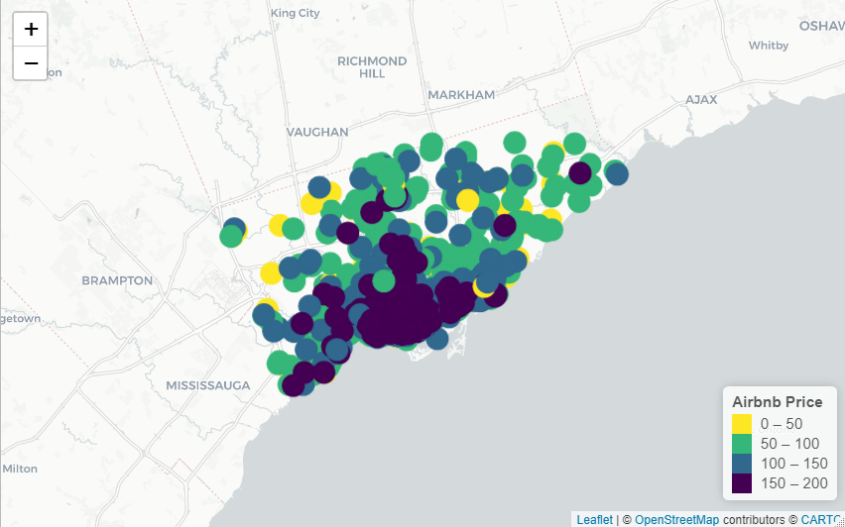
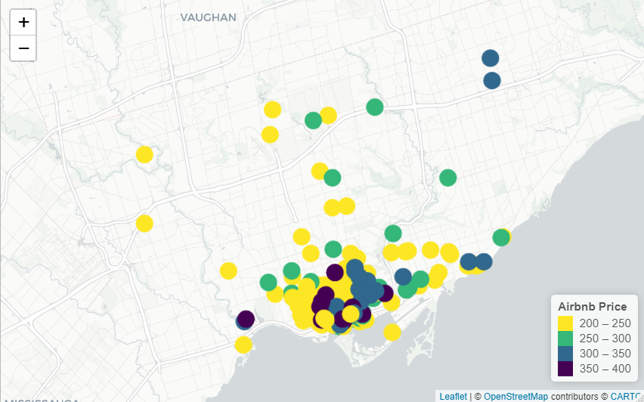
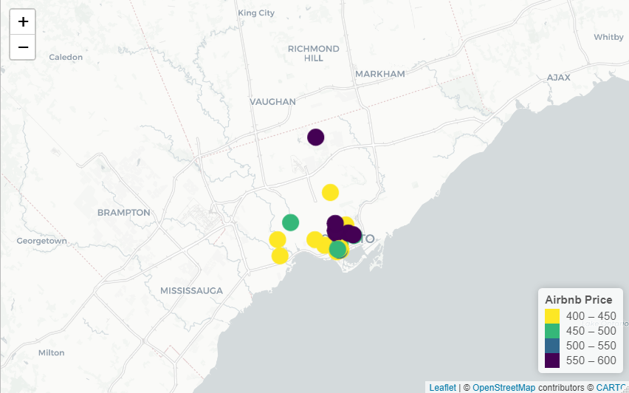
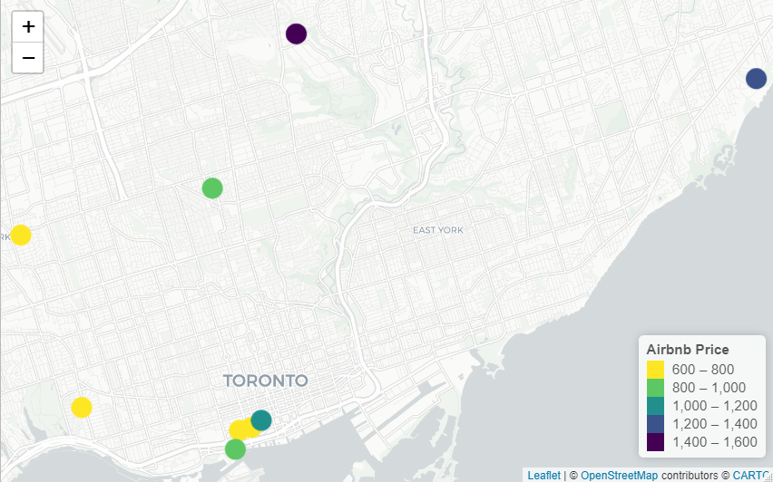

Slide 9
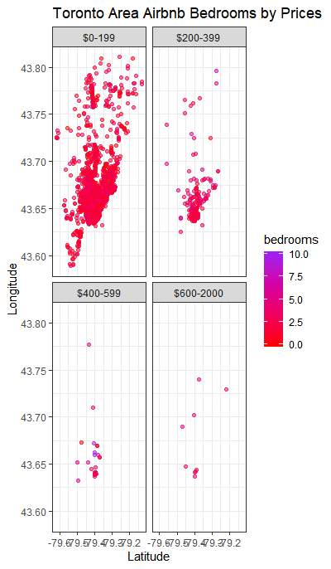
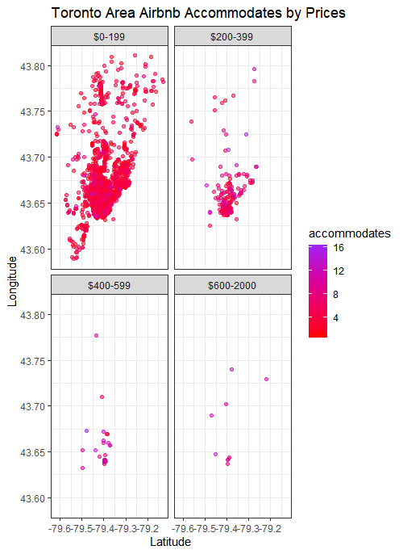
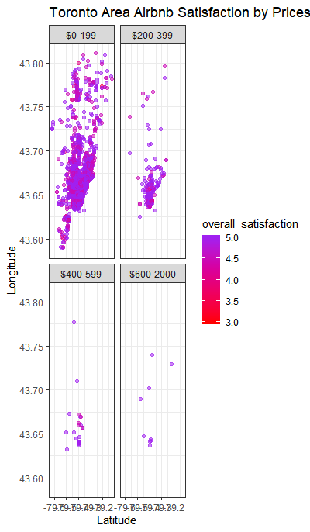

Slide 10
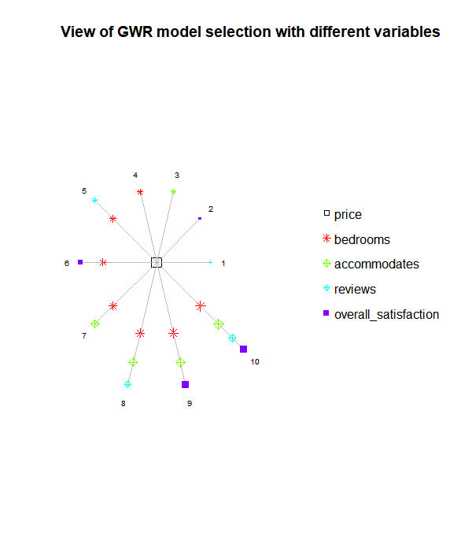
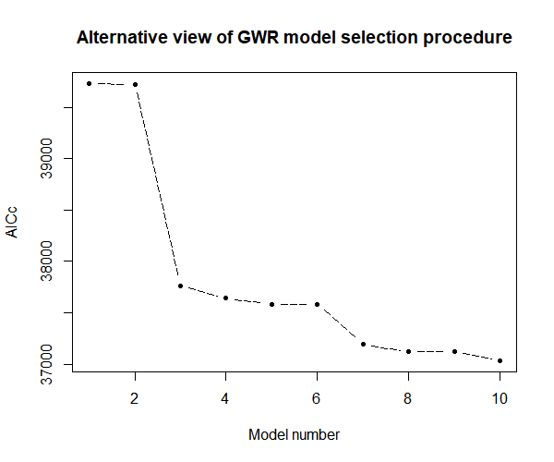
Methods

Slide 11
Global Regression (no spatial)
lm(formula = price ~ bedrooms + accommodates, data = airbnb.spdf)
Residuals:
Min 1Q Median 3Q Max
-229.32 -28.62 -5.73 19.94 1296.46
Coefficients:
Estimate Std. Error t value Pr(>|t|)
(Intercept) 34.098 2.233 15.27 <2e-16 ***
bedrooms 25.330 1.668 15.19 <2e-16 ***
accommodates 11.816 0.763 15.48 <2e-16 ***
---
Signif. codes: 0 ‘***’ 0.001 ‘**’ 0.01 ‘*’ 0.05 ‘.’ 0.1 ‘ ’ 1
Residual standard error: 61.29 on 3498 degrees of freedom
Multiple R-squared: 0.3315, Adjusted R-squared: 0.3311
F-statistic: 867.2 on 2 and 3498 DF, p-value: < 2.2e-16

Slide 12
GW Regression (Gaussian n=25)
****************Summary of GWR coefficient estimates:******************
Min. 1st Qu. Median 3rd Qu. Max.
Intercept -80.4847 25.8642 42.3964 58.7483 108.330
bedrooms -17.0074 19.9363 30.6898 42.3791 88.715
accommodates -10.7478 2.5635 7.3507 12.5474 50.360
************************Diagnostic information*************************
Number of data points: 3501
Effective number of parameters (2trace(S) - trace(S'S)): 311.6664
Effective degrees of freedom (n-2trace(S) + trace(S'S)): 3189.334
AICc (GWR book, Fotheringham, et al. 2002, p. 61, eq 2.33): 38169.29
AIC (GWR book, Fotheringham, et al. 2002,GWR p. 96, eq. 4.22): 37916.55
Residual sum of squares: 9724032
R-square value: 0.5051939
Adjusted R-square value: 0.4568256

Slide 13
GW Regression (Bisquare n=52)
****************Summary of GWR coefficient estimates:******************
Min. 1st Qu. Median 3rd Qu. Max.
Intercept -391.52304 23.58198 44.49292 63.32075 143.17
bedrooms -56.14920 17.74690 28.08862 44.50505 244.86
accommodates -22.20219 -0.18479 6.34899 12.56351 107.92
************************Diagnostic information*************************
Number of data points: 3501
Effective number of parameters (2trace(S) - trace(S'S)): 711.8997
Effective degrees of freedom (n-2trace(S) + trace(S'S)): 2789.1
AICc (GWR book, Fotheringham, et al. 2002, p. 61, eq 2.33): 37432.02
AIC (GWR book, Fotheringham, et al. 2002,GWR p. 96, eq. 4.22): 36695.1
Residual sum of squares: 6265209
R-square value: 0.6811957
Adjusted R-square value: 0.5997938

Slide 14
GW Regression (Boxcar n=17)
****************Summary of GWR coefficient estimates:******************
Min. 1st Qu. Median 3rd Qu. Max.
Intercept -440.3936 22.2207 46.0475 68.3701 191.09
bedrooms -56.6107 12.3792 27.2465 45.9967 276.59
Accommodates -41.6917 -1.7333 5.2652 13.295 124.06
************************Diagnostic information*************************
Number of data points: 3501
Effective number of parameters (2trace(S) - trace(S'S)): 615.7707
Effective degrees of freedom (n-2trace(S) + trace(S'S)): 2885.229
AICc (GWR book, Fotheringham, et al. 2002, p. 61, eq 2.33): 37776.46
AIC (GWR book, Fotheringham, et al. 2002,GWR p. 96, eq. 4.22): 36894.38
Residual sum of squares: 6486829
R-square value: 0.6699186
Adjusted R-square value: 0.5994476

Slide 15
GW Regression (Exponential n=24)
****************Summary of GWR coefficient estimates:******************
Min. 1st Qu. Median 3rd Qu. Max.
Intercept -29.4487 28.0906 41.3673 56.4462 102.138
bedrooms -7.3279 21.4523 31.2860 40.6259 83.650
accommodates -7.2938 4.0587 8.1693 12.4206 31.851
************************Diagnostic information*************************
Number of data points: 3501
Effective number of parameters (2trace(S) - trace(S'S)): 390.297
Effective degrees of freedom (n-2trace(S) + trace(S'S)): 3110.703
AICc (GWR book, Fotheringham, et al. 2002, p. 61, eq 2.33): 38188.85
AIC (GWR book, Fotheringham, et al. 2002,GWR p. 96, eq. 4.22): 37908.48
Residual sum of squares: 9642705
R-square value: 0.5093323
Adjusted R-square value: 0.4477488

Slide 16
GW Regression (Tri-cube n=52)
****************Summary of GWR coefficient estimates:******************
Min. 1st Qu. Median 3rd Qu. Max.
Intercept -407.11622 23.73833 44.56882 63.65291 149.85
bedrooms -60.45473 17.52175 28.07152 44.45427 241.60
accommodates -23.63554 -0.28714 6.37127 12.51895 108.02
************************Diagnostic information*************************
Number of data points: 3501
Effective number of parameters (2trace(S) - trace(S'S)): 638.2768
Effective degrees of freedom (n-2trace(S) + trace(S'S)): 2862.723
AICc (GWR book, Fotheringham, et al. 2002, p. 61, eq 2.33): 37448
AIC (GWR book, Fotheringham, et al. 2002,GWR p. 96, eq. 4.22): 36771.17
Residual sum of squares: 6465453
R-square value: 0.6710063
Adjusted R-square value: 0.5976278

Slide 17
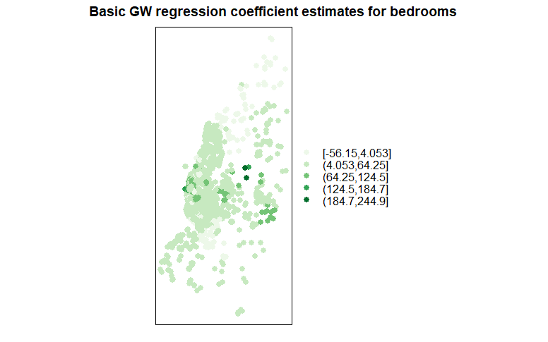
Question #1: What this means and significance?

Slide 18
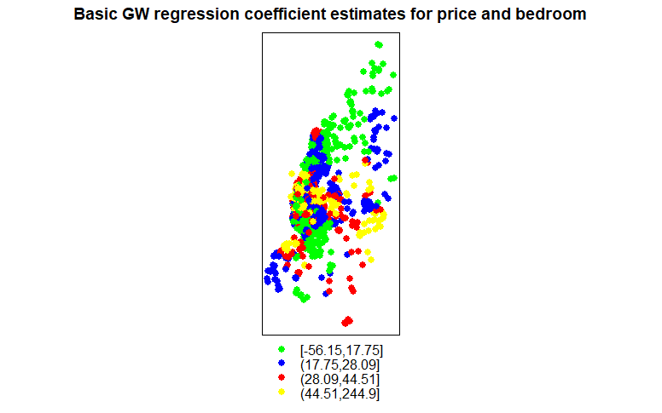
Question #2: What this means and significance?

Slide 19
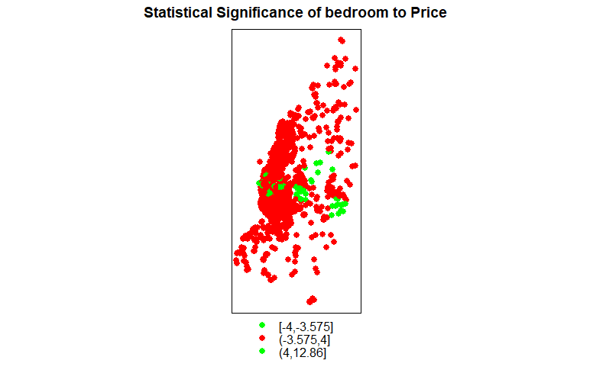
Question #3: What this means and significance?

Slide 20
Log Price?
****************Summary of GWR coefficient estimates:******************
Min. 1st Qu. Median 3rd Qu. Max.
Intercept 3.3677385 3.9493384 4.1473118 4.3209720 4.6060
bedrooms -0.0056666 0.1782835 0.2401659 0.3010037 0.5471
Accommodates -0.0774558 0.0165339 0.0468546 0.0723782 0.2121
************************Diagnostic information*************************
Number of data points: 3501
Effective number of parameters (2trace(S) - trace(S'S)): 256.472
Effective degrees of freedom (n-2trace(S) + trace(S'S)): 3244.528
AICc (GWR book, Fotheringham, et al. 2002, p. 61, eq 2.33): 2165.895
AIC (GWR book, Fotheringham, et al. 2002,GWR p. 96, eq. 4.22): 1952.988
Residual sum of squares: 339.2658
R-square value: 0.553236
Adjusted R-square value: 0.5179095

Slide 21
